Slide 1
Announcement of Final Project
2025/11/11
TA 郭建廷

Slide 2
We will talk about some crucial updates regarding the final project
For more information, please refer to the updated specification PDF.

Slide 3
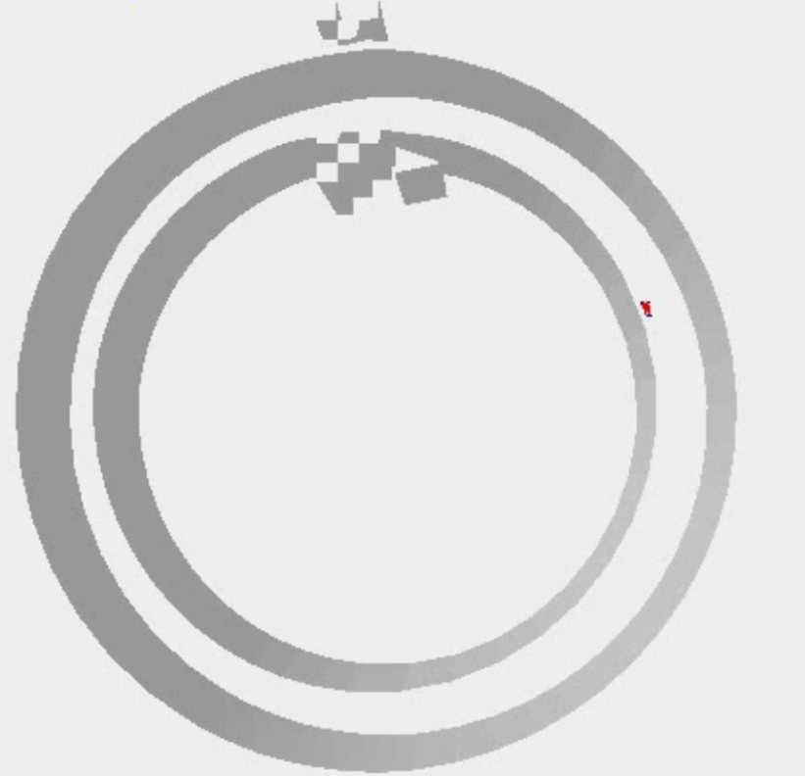
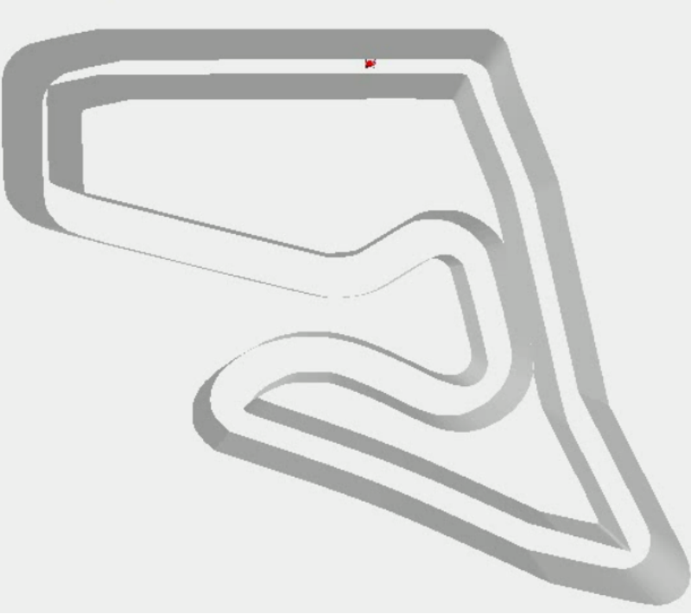
Maps
Circle_cw
Austria
Unknown
25 sec
100 sec

Slide 4
The Randomness Environment during the Demo
We may introduce some randomness, such as:
Adding a bit of noise to your action
Randomizing the starting point
Therefore, please ensure to train a stable model!
The randomness used may vary on different demo days

Slide 5
Scoring Criteria
Your total project score = report * 0.2 + demo performance * 0.8

Slide 6
Scoring Criteria
 | Circle_cw | Austria
Threshold 1 | 20% (finish a lap) | 15% (finish first curve without collision)
Threshold 2 | - | 5% (finish second curve without collision)
Ranking | 20% | 20%

Slide 7

Scoring Criteria (Unknown)
Unknown map:
You can use any of your models to evaluate on this map, the map is not released (it may be larger noise or new map).
Ranking: 20% of the demo score.

Slide 8
Scoring Criteria (bonus)
Bonus:
If you use the same model to evaluate both maps and you pass both the Circle_cw baseline and Austria baseline 1/2: +5% of the demo score (up to 100)

Slide 9
Important Announcement regarding the Demo
You NEED to DEMO to get performance grades
Different maps can be tested with different models
Pre-recorded action sequences are prohibited during the demonstration
You have several chances to demo, and the highest score will be chosen in the end. (including the bonus)

Slide 10
Important Announcement regarding the Report
We mainly score based on the effort and learning people put into "Reinforcement Learning" and "Neural Network Training".
If your content DOES NOT relate to at least one of the topics mentioned above, you will receive NO
score in the report part.
For instance, you might craft an "if-else" program that could potentially achieve a decent score in the demo performance. However, if that is your only effort, you will receive no points in the report section.

